Slide 1
Summer Program presentation

Slide 2
Directory
1.General information about our project
2. Details and unique design
3. How did we work in a group?

Slide 3
General information
1

Slide 4



General information
Based on SMART ON FHIR(Fast Healthcare Interoperability Resource)
HTML 5 ----framework
CSS ---- decoration
Js ---- gear
website

Slide 5
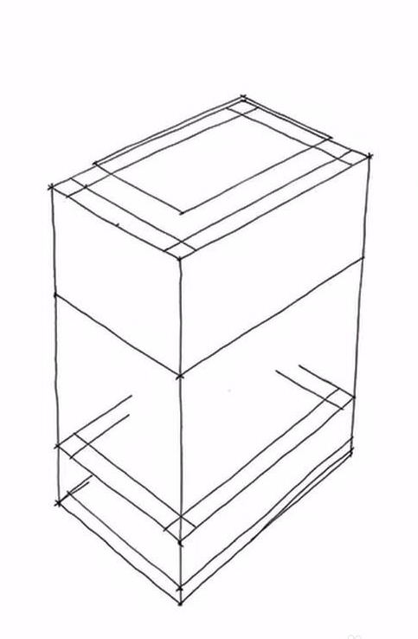
Soda Fountain

Slide 6
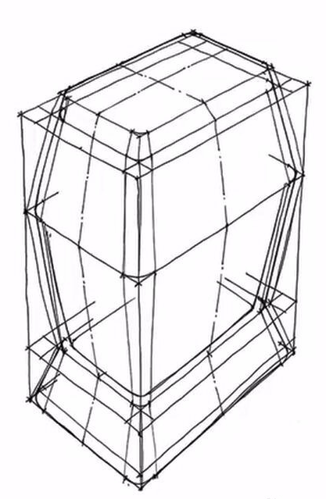
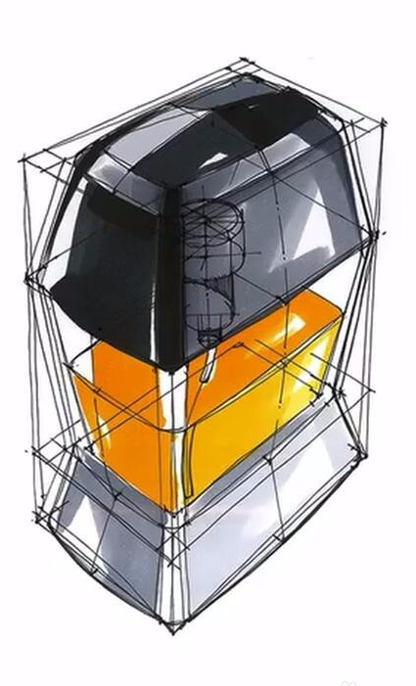
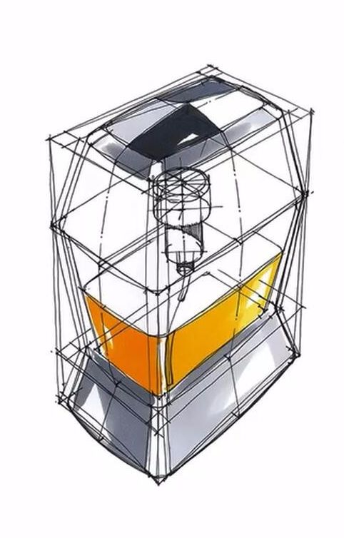

Slide 7
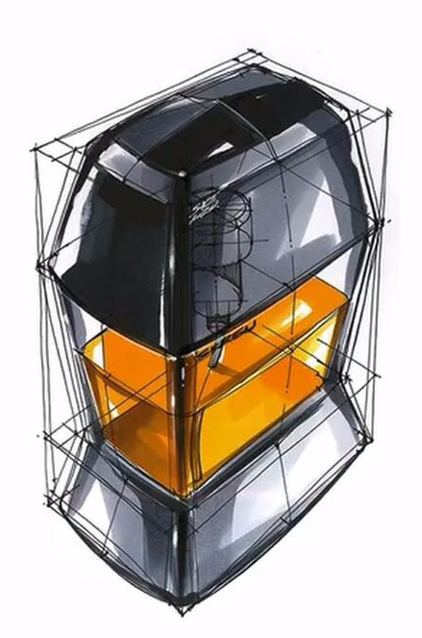

Slide 8
Our process is easy
Build website framework with html 5
Use js to achieve specific function of website
Use css to make website more beautiful
1
2
3

Slide 9
Details & unique design
2

Slide 10
Function!

Slide 11

Github
3
How did we work in a group？

Slide 12

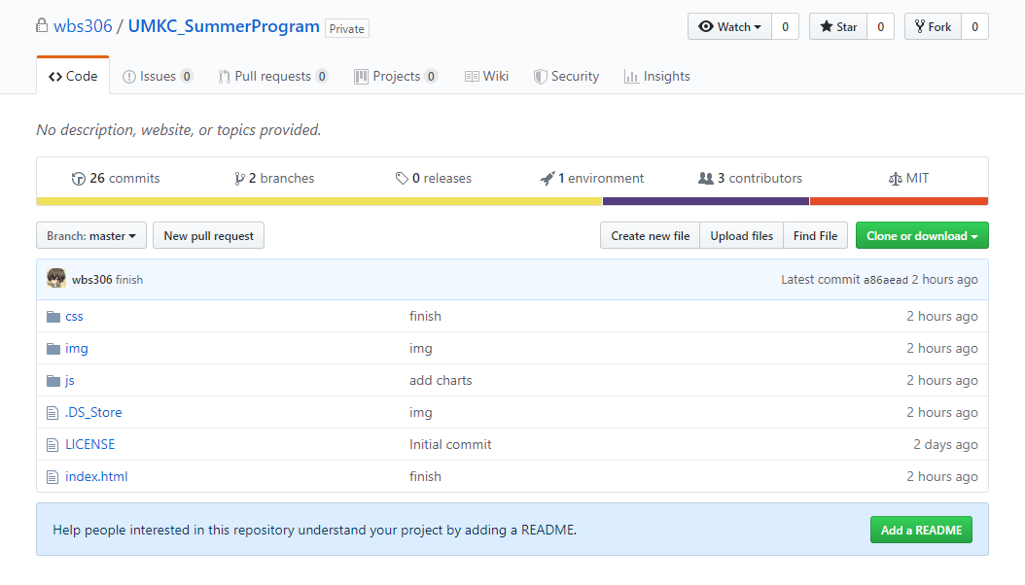
Share code

Slide 13
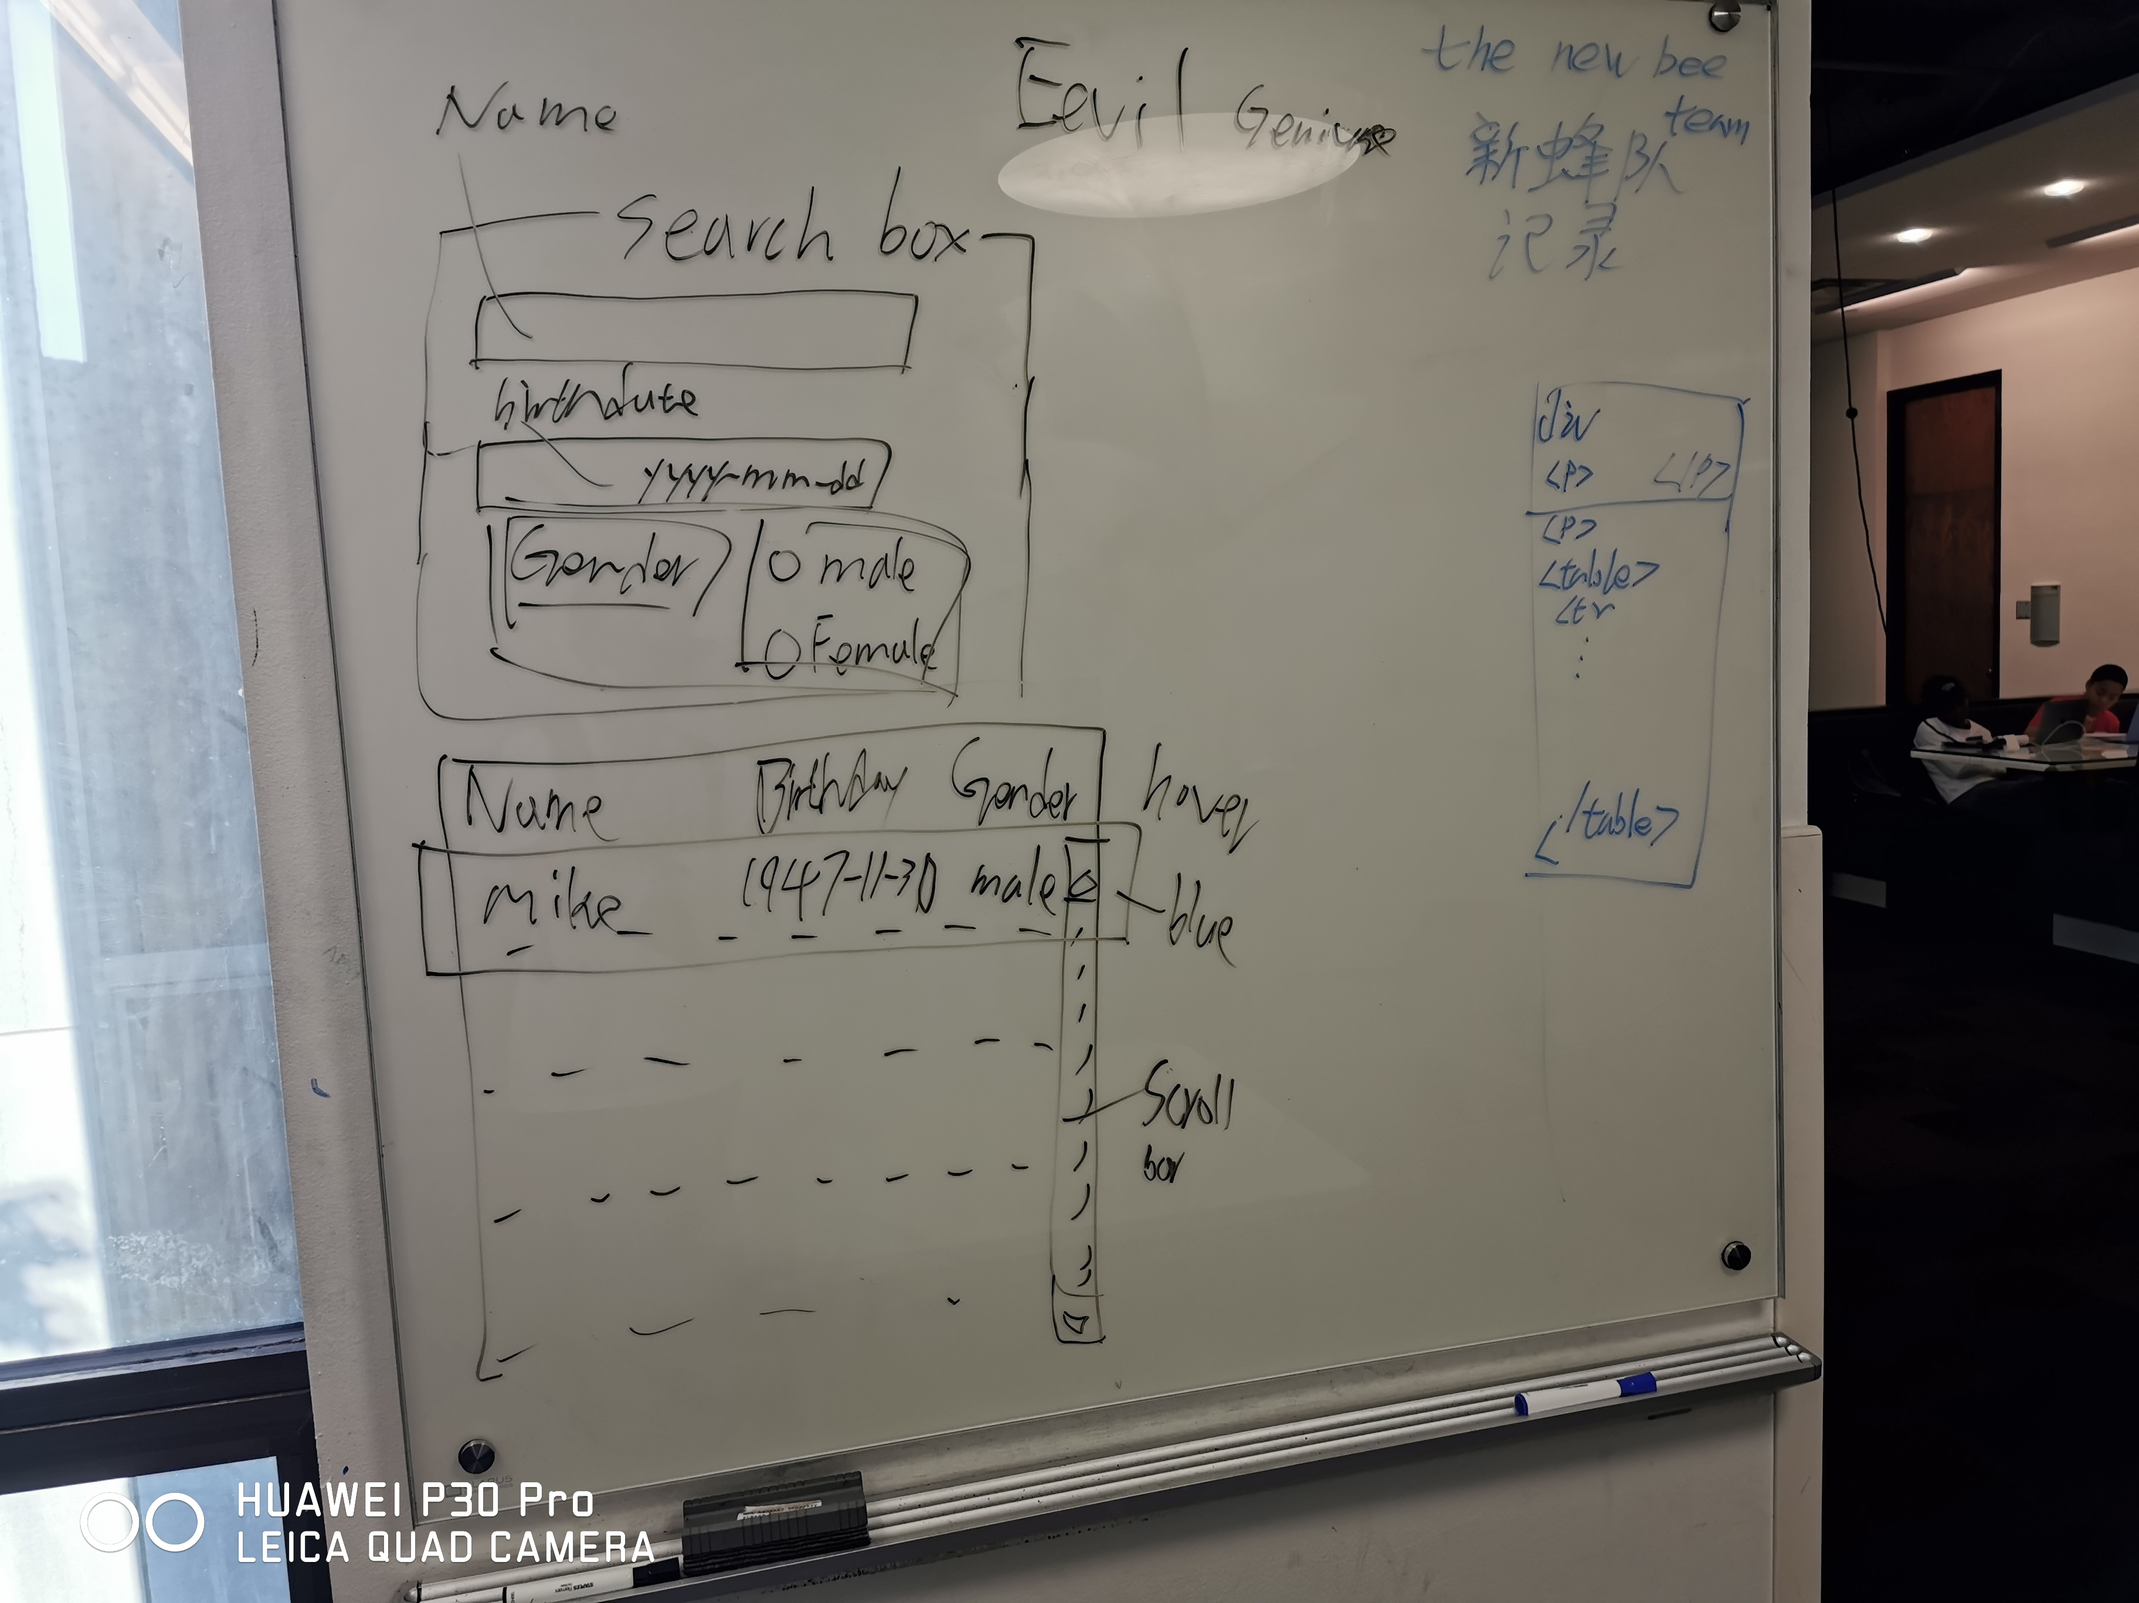
Group member
Hanquan,Xu ---- html
Zihe,Li ---- css
Hebin,Huang ---- js
Haoran,Nie ---- presentation

Slide 14

conclusion

Slide 15

What have we learned from our project?
HTML 5
CSS
JAVA SCRIPT
GITHUB
GROUP WORK
OPTIMISM

Slide 16
Thanks!

